Slide 1

CSE101-Lec#20
Strings

Slide 2
Fundamentals of characters
Characters
Building blocks of programs
Every program is a sequence of meaningfully grouped characters
Character constant
An int value represented as a character in single quotes

Slide 3
Fundamentals of strings
Strings
Array of characters treated as a single unit called string:
Can include letters, digits and special characters (*, /, $)
String literal (string constant) - written in double quotes
“Lovely Professional University."

Slide 4
Fundamentals of strings
Strings are arrays of characters
String is a pointer to first character
Name of string is the address of first character
Each element of the string is stored in a contiguous memory locations.
Terminated by a null character(‘\0’) which is automatically inserted by the compiler to indicate the end of string.

Slide 5
String Definition
They are defined as
char array_name[size];
e.g. char carname[30];
It defines an array name and reserves 30 bytes for storing characters and single character consumes 1 bytes each.
Since the last byte is used for storing null character so total number of character specified by the user cannot exceed 29.

Slide 6
String Initialization
Initialization
char m[9] = “I like C”;
char m[ ] = “I like C”;
char m[ ] = { ‘I’, ‘ ’, ‘l’, ‘i’, ‘k’, ‘e’, ‘ ’,’C’ };
char m[ ] ={ { ‘I’ },{ ‘l’ },{ ‘i’ },{ ‘k’ },{ ‘e’ },{‘u’ } };

Slide 7
The empty brackets notation [] tells the compiler to calculate the size of the array automatically. This is in fact the same as allocating it explicitly, adding one to the length of the string:
char name[] = "John Smith"; /* is the same as */
char name[11] = "John Smith";
The reason that we need to add one, although the string John Smith is exactly 10 characters long, is for the string termination, a special character (equal to 0) which indicates the end of the string.

Slide 8
String Input/Output
You can use the scanf() function to read a string like any other data types.
However, the scanf() function only takes the first entered word. The function terminates when it encounters a white space (or just space).
Inputting strings
Use scanf.
scanf("%s", word);
Copies input into word[]
Do not need &
Because strings are arrays of characters and arrays name contains in itself the address of the first index location it points to.It happens because array name is nothing but a pointer pointi ng to the first location in array.
So the name of the string is itself the address of string. When you write the name of an array , it implies its base address.
Displaying strings
Use printf.
printf("%s", word);

Slide 9
Exercise
Define the string first_name with the value John using the pointer notation, and define the string last_name with the value Doe using the local array notation

Slide 10
#include <stdio.h>
void main()
{
char carname[20]; //string char array
printf(“Enter the name of your car: ");
scanf("%s", carname);
// to display the input
printf(“\nName of car is %s", carname);
} //end main
Program to read and display string
Enter the name of your car: XUV500
Name of car is XUV500
Output

Slide 11
How?
The last program will print only a single word not the sentences with white spaces?
That is if input is
Lovely Professional University
Output will be:
Lovely
So how to print:
Lovely Professional University
use gets and puts

Slide 12
Standard I/O Library Functions
To do anything else with strings, we must typically call functions. The C library contains a few basic string manipulation functions, and to learn more about strings, we'll be looking at how these functions might be implemented.
List of functions in #include<stdio.h>
Used for string input/output functions.
Function | Description
gets( char *s ); | Inputs characters from the standard input into the array s until a newline or end-of-file character is encountered. A terminating null character is appended to the array.
puts( const char *s ); | Prints the string s followed by a newline character.

Slide 13
Standard I/O Library Functions
To make life easier, there are predefined functions gets() and puts in C language to read and display string respectively.

Slide 14
#include <stdio.h>
void main()
{
char name[100]; //string char array
puts(“\nEnter a string: ”);
gets(name); //to input string with space
printf(“\nString is: ”)
puts(name); //to output const string
}//end main
Program to print strings with white spaces using library functions
Enter a string:
Lovely Professional University
String is:
Lovely Professional University
Output

Slide 15
#include <stdio.h>
void main()
{
char name[]={“Lovely Professional University"}; //string char array
int i=0;
while(name[i]!='\0') //untill null character
{
printf("%c", name[i]);
i++;
}//end while
}//end main
Program to print strings character by character using loop.
Lovely Professional University
Output

Slide 16
String Handling Library
Functions defined in #include<string.h>
String handling library provides many useful functions:
Manipulate string data(copy and concatenate)
Comparing strings
Determine string length
Search strings

Slide 17
String Manipulation Functions
List of string manipulation functions
Function | Work
strlen() | Calculates the length of string
strcpy() | Copies a string to another string
strcat() | Concatenates(joins) two strings
strcmp() | Compares two string
strlwr() | Converts string to lowercase
strupr() | Converts string to uppercase

Slide 18
Determining the length of string
strlen()
Function strlen in #include<string.h>
Function strlen() takes a string as an argument and returns the number of characters in the string
the terminating null character is not included in the length
Syntax of strlen()
strlen(string_name);

Slide 19
#include <stdio.h>
#include <string.h>
int main()
{
char a[20]="Program";
Char b[20]={'P','r','o','g','r','a','m','\0'};
char c[20];
printf("Enter string: ");
gets(c);
printf("Length of string a=%d \n",strlen(a));
//calculates the length of string before null charcter.
printf("Length of string b=%d \n",strlen(b));
printf("Length of string c=%d \n",strlen(c));
return 0;
}
Program demonstrates string length function strlen()

Slide 20
Enter string: String
Length of string a=7
Length of string b=7
Length of string c=6

Slide 21
strcpy() and strncpy()
strcpy() copies the entire second argument string into first argument.
strcpy( s1, s2);
strncpy() copies the first n characters of second string argument into first string argument.
strncpy( s1, s2, 4);
The third argument is less than the string length of the second argument.

Slide 22
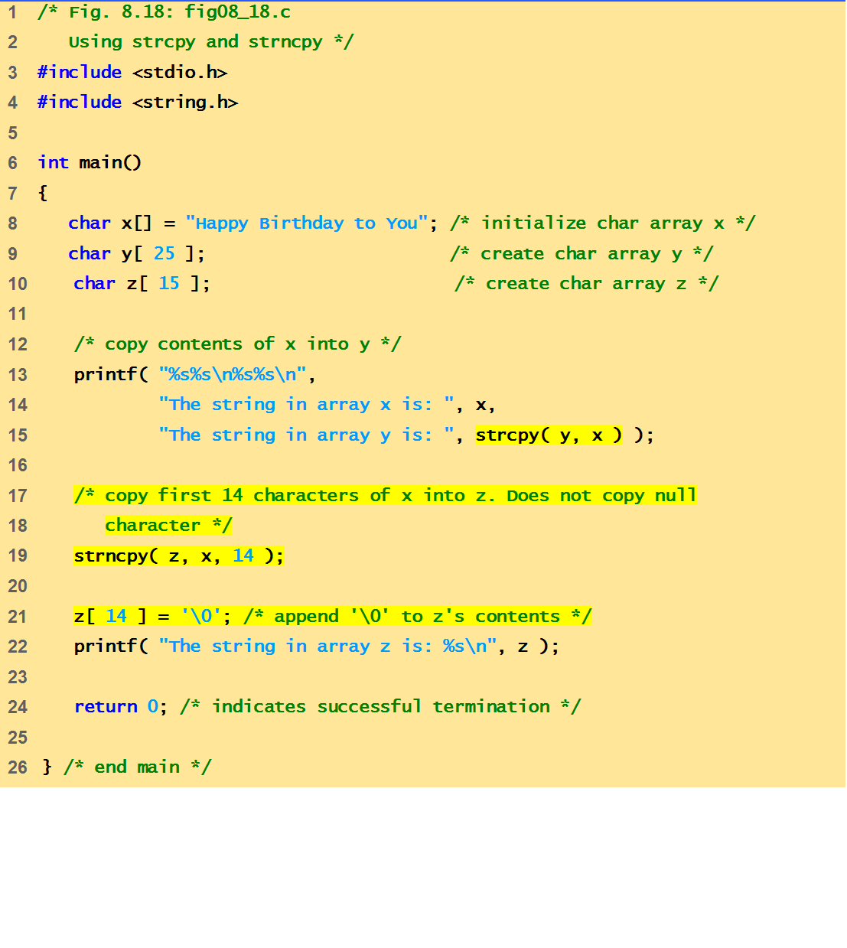
Example Code
This program demonstrates string manipulation/ processing functions: strcpy() and strncpy()

Slide 23
Output
The string in array x is: Happy Birthday to You
The string in array y is: Happy Birthday to You
The string in array z is: Happy Birthday

Slide 24

strcat()
Function strcat appends its second argument string to its first argument string.
strcat( s1, s2);
The array used to store the first string should be large enough to store
the first string
the second string and
the terminating null character copied from the second string.
Quick yak:
Ask the students to work with f_name, l_name arrays of their names using
Strcat()

Slide 25
strncat()
Function strncat appends a specified number of characters from the second string to the first string.
strncat( s1, s2, 6)
A terminating null character is automatically appended to the result.

Slide 26
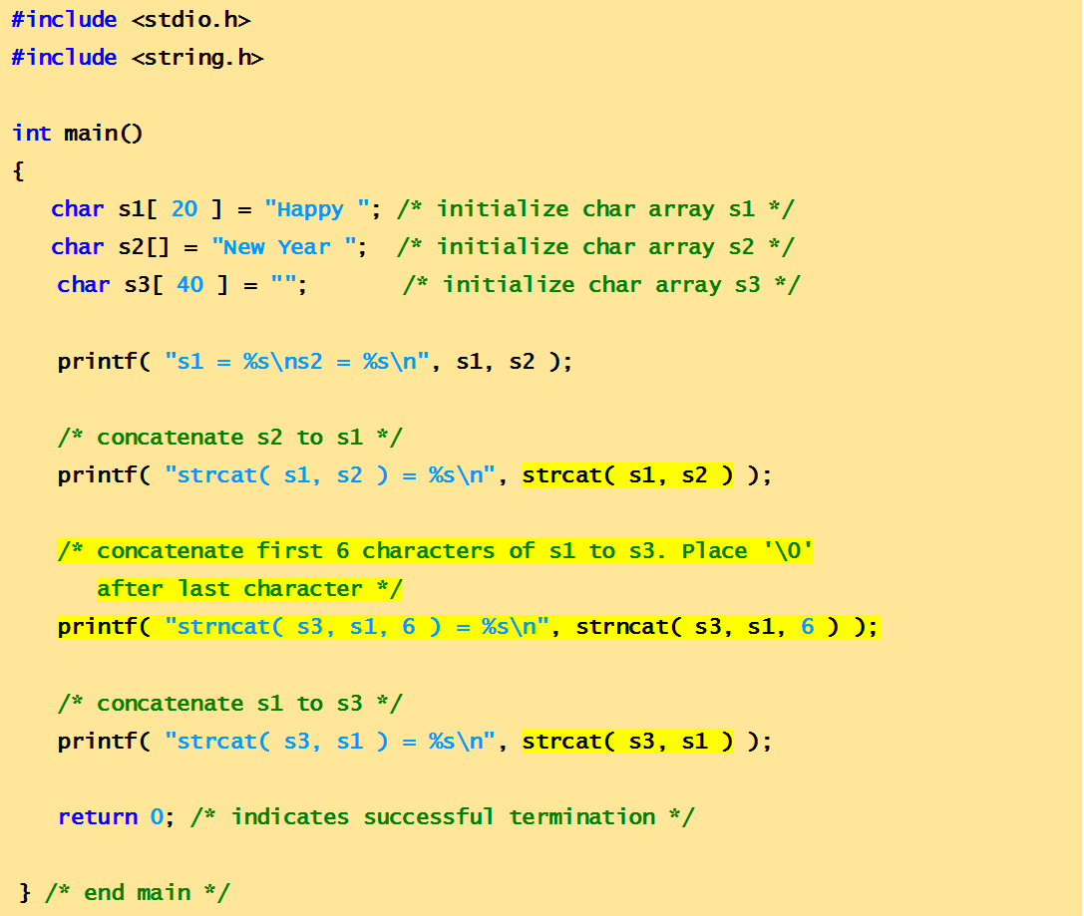
Example Code
This program demonstrates string manipulation/ processing functions: strcat() and strncat()

Slide 27
output
s1 = Happy
s2 = New Year
strcat( s1, s2 ) = Happy New Year
strncat( s3, s1, 6 ) = Happy
strcat( s3, s1 ) = Happy Happy New Year
Quick yak:
Ask students to print their names as:
Ankur Sharma
Sharma Ankur
Ankur S.
A. Sharma

Slide 28
Comparison Functions of the String Handling Library
Comparing strings
Computer compares numeric ASCII codes of characters in string
strcmp() Compares its first string argument with its second string argument, character by character.
Function strncmp() does not compare characters following a null character in a string.

Slide 29
strcmp()
int strcmp( s1, s2 );
Compares string s1 to s2
a negative number if s1 < s2,
zero if s1 == s2
a positive number if s1 > s2
Quick yak:
Comparison of strings:
Meghalaya
Manipur
To be discussed

Slide 30
int strncmp( s1, s2, int n);
int stricmp(s1,s2);
int strnicmp(s1,s2,int n);

Slide 31
strlwr()
strlwr() function converts all the uppercase characters in that string to lowercase characters
Syntax of strlwr()
strlwr(string_name);

Slide 32
#include <stdio.h>
#include <string.h>
int main()
{
char str1[]="LOWer Case";
puts(strlwr(str1));
//converts to lowercase and displays it.
return 0;
}
Example of strlwr()

Slide 33
Output: lower case

Slide 34
strupr()
strupr() function converts all the lowercase characters in that string to uppercase characters.
Syntax of strupr()
strupr(string_name);

Slide 35
#include <stdio.h>
#include <string.h>
int main()
{
char str1[]="UppEr Case";
puts(strupr(str1));
//Converts to uppercase and displays it.
return 0;
}
Example of strupr()

Slide 36
Output: UPPER CASE

Slide 37
strrev()
strrev( ) function reverses a given string in C language. Syntax for strrev( ) function is given below: strrev(string);

Slide 38
strchr()
strchr( ) function returns pointer to the first occurrence of the character in a given string.
Syntax for strchr( ) function is given below: strchr(str, int character);

Slide 39
strrchr( )
strrchr( ) function in C returns pointer to the last occurrence of the character in a given string.
Syntax for strrchr( ) function is given below. strrchr(str, character);

Slide 40
Strstr()
The C library function finds the first occurrence of the substring in the string . The terminating '\0' characters are not compared.
Following is the declaration for strstr() function.
strstr(string, substring);
This function returns a pointer to the first occurrence in string of any of the entire sequence of characters specified in substring, or a null pointer if the sequence is not present in haystack.

Slide 41
Other Functions

Slide 42
strset():-
strset( ) function sets all the characters in a string to given character. Syntax for strset( ) function is given below. strset(string, given character);
Example:
char a[]=“Hello”;
strset(a,’#’);
Output:
#####

Slide 43
strnset()
strset( ) function sets n number characters in a string to given character. Syntax for strset( ) function is given below. strnset(string, given character, n);
Example:
char a[]=“Hello”;
strset(a,’#’,3);
Output:
###lo

Slide 44
strdup()
strdup( ) function in C duplicates the given string. Syntax for strdup( ) function is given below. strdup(string);
Same as strcpy

Slide 45
strtok()
strtok( ) function in C tokenizes the given string using delimiter. Syntax for strtok( ) function is given below: strtok ( str, delimiters );
Example:
char a[]=“Test1;test2:test3,test4”;
strtok(a,”:;,”);
Output:
Test1 test 2 test3 test4

Slide 46
Next Lecture
Mining different types of data from string …??
String conversion functions

